Slide 1
Quiz 2 – September 19 2017
Question 1
The porosity of biomaterials increases their thermal conductivity :
True
False

Slide 2
Question 2 – Select the right statement
The thermal conductivity of a biomaterial affects the temperature gradient created during a heat transfer process of the following manner:
The larger is the thermal conductivity of the biomaterial the smaller is the temperature gradient
The smaller is the thermal conductivity of the biomaterial the smaller is the temperature gradient
The larger is the thermal conductivity of the biomaterial the larger is the temperature gradient
There is no relationship between the temperature gradient in a heat transfer process and the thermal conductivity of the material

Slide 3
Question 3. Select the right statement related to thermal diffusivity defined as
The porosity of a biomaterial does not affect its thermal diffusivity
Thermal diffusivity is a property of a biomaterial that has a large value and gives the ability of the material to conduct heat
The porosity of biomaterials decreases their thermal diffusivity
Thermal diffusivity is the ratio of the ability of the material to conduct heat and its thermal inertia and increases with the porosity of the material

Slide 4
Question 4
Select the right statement
The time for thawing a frozen biomaterial is longer than the time for freezing the same material because the thermal conductivity of ice is about 4 times larger than that of water.
The time for thawing a frozen biomaterial is longer than the time for freezing the same material because the thermal conductivity of ice is approximately equal than that of water.
The time for thawing a frozen biomaterial is shorter than the time for freezing the same material because the thermal conductivity of ice is smaller than that of water.
The time for thawing a frozen biomaterial is shorter than the time for freezing the same material because the thermal conductivity of ice is approximately equal than that of water.

Slide 5
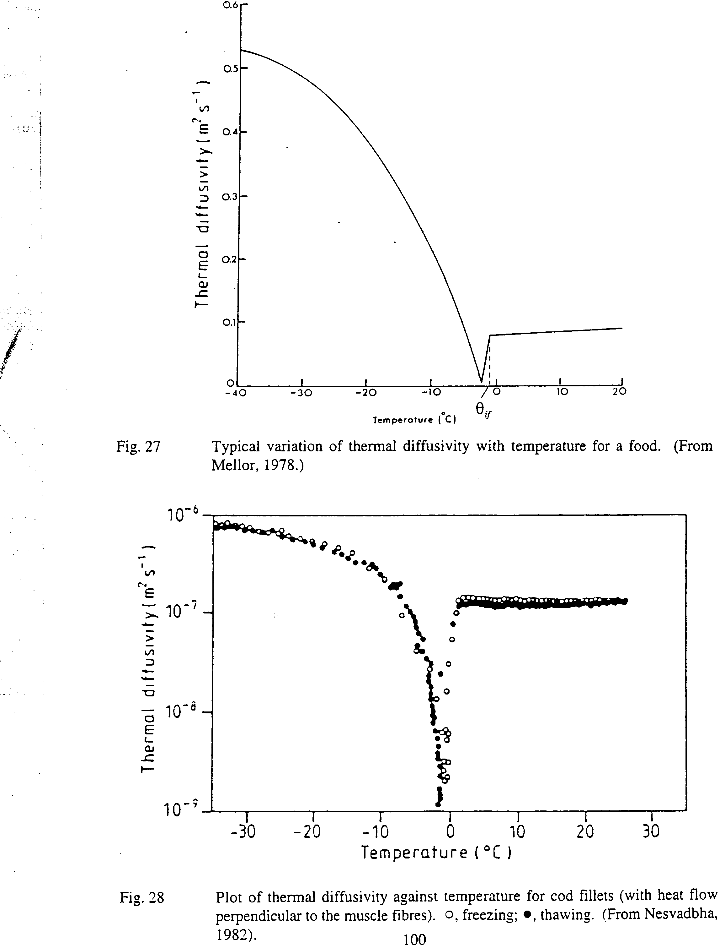
Question 5: Consider the plot of thermal diffusivity versus temperature on right, select the right statement concerning the sudden decrease of the thermal diffusivity at the freezing temperature range
The decrease is due to large changes in density around that temperature range
The decreases is due to the formation of ice and the decrease of the biomaterial thermal conductivity
The decrease is due to the formation of ice and the increase of the biomaterial heat capacity
The decrease is due to the fact that porous biomaterials contain more ice

